Slide 1

Capstone Project Phase 2 System for smart common sports ground management Project number: 24-1-D-1 Date: 22/09/2024
Advisor:
Prof. Zeev Frenkel Ebrahem Enbtawe
208047357 Obied Haddad
206989295
‹#›
Notes:
Hi Everyone, Thank you for being here today. We are excited to present our “System for smart common sports grounds management” me Obied and my partner Ebrahem, under the guidance of our advisor Dr.Zeev Frankel

Slide 2







Outline
INTRODUCTION
PROBLEMS AND SOLUTIONS
VIDEO
TECHNOLOGIES USED
UML DIAGRAMS
TESTS
THECHNICAL CHALLENGES
Notes:
Here is what we are going to talk about today,
First we will introduce our project,
Then, we’ll present the problems we aimed to solve.
Next, we’ll explain our solution.
After that, we’ll show a real-time video demonstration of the application’s user interface and functionality,
Then, We’ll highlight the technologies we used to create the system.
Finally, we’ll review the project structure using UML diagrams
followed by a review of the tests conducted and the technical challenges we addressed.

Slide 3
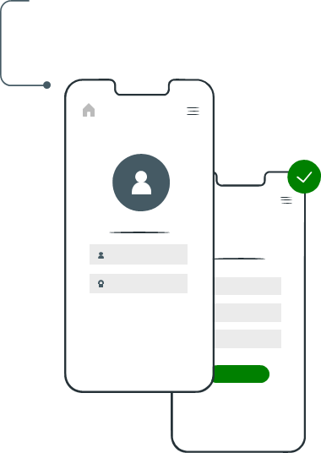
01
Introduction
‹#›
Notes:
This system automates the booking and management of sports fields, offering real-time availability, conflict resolution, and GPS-based field suggestions

Slide 4
Introduction
Growing Demand: As the need for efficient sports field management systems rises, organizations are looking for seamless, scalable solutions.
Key Challenges: Traditional reservation systems face difficulties with real-time availability, location-based recommendations, and managing overlapping bookings.
Our Solution: Our platform integrates cutting-edge features, offering real-time availability, GPS-based recommendations, and advanced conflict resolution algorithms, all in a single, user-friendly system.
Notes:
More and more people are booking sports fields online, so organizations need a system that’s easy to use and can handle a lot of bookings.
But traditional systems have problems, like showing available fields in real-time, suggesting nearby options, and managing double bookings.
Our solution fixes these issues. It offers real-time field availability, gives location-based recommendations using GPS, and handles booking conflicts automatically,
all in one simple and user-friendly system.

Slide 5

02
Problems And Challenges
‹#›
Notes:
In this section, we’ll go over the main problems and challenges we identified when building this system.

Slide 6
The Problems and the Challenges that we wanted to solve
01
02
03
Objective
The goal is to minimize reservation time by quickly matching users with the nearest available sports field based on location.
Personalization
We allow users to personalize their reservation experience by selecting preferred fields and avoiding those with past negative experiences.
Conflict Resolution
Users trying to book the same field at the same time faced conflicts, causing frustration and inefficient field usage.
‹#›
Notes:
Our main goal was to solve three key problems:
Objective: The goal is to minimize reservation time by quickly matching users with the nearest available sports field based on location.
Personalization: Users need to customize their experience by selecting preferred fields while avoiding ones that caused previous negative experiences.
Conflict Management: Handling overlapping bookings was a major challenge. Without a proper system, users trying to book the same field at the same time faced conflicts, causing frustration and inefficient field usage.

Slide 7

03
We resolved the issues by implementing the following solutions
‹#›
Notes:
We identified the key challenges and addressed them through several technical solutions,
ensuring that our system remains efficient, user-friendly, and effective in handling the reservation process.

Slide 8
How Did We Ensure Optimal Field Allocation for Reservations?
We continuously track the availability of each sports field. When a field manager updates its status, the system ensures real-time accuracy and up-to-date matching.
Each field’s GPS coordinates are stored in the system, ensuring precise identification of locations and smoother booking flows for users.
Upon a reservation request, the system calculates the proximity of all available fields and suggests the nearest option, ensuring optimized field allocation.
‹#›
Notes:
We track each sports field’s availability in real-time.
This means that when a field manager updates the field’s status, the system quickly adjusts to ensure all users see the most up-to-date information.
We also store the GPS coordinates of each field, so users can easily find the closest available fields.
When someone wants to book, our system calculates which field is closest and available,
providing the best option to make the booking process as smooth and efficient as possible.

Slide 9
How Did We Incorporate User Preferences in Field Selection?
After calculating the proximity of available sports fields, the system filters results based on user preferences, such as field type, past positive experiences, and preferred time slots.
This ensures users receive personalized field suggestions that enhance their overall booking experience, making the system more user-centric and adaptable.
‹#›
Notes:
This slide shows how we use user preferences to choose the best fields.
After finding nearby fields, the system filters the results based on what the user likes, such as the type of field,
positive past experiences, and their favorite times.
This way, users get personalized suggestions that improve their booking experience, making the system more focused on what each user prefers.

Slide 10
How to Ensure User Choices Don’t Impact System Efficiency
Optimized Field Options
Fields exceeding the distance threshold are excluded to maintain relevant choices for users.
Performance Focus
Filtering ensures fast processing and avoids unnecessary delays during booking.

Slide 11
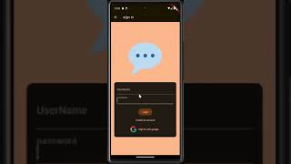
Now we will present our App!
‹#›

Slide 12



Technologies used
‹#›
Notes:
Lets take a look at the technologies we used to build our APP 1. For the frontEnd we have used Flutter a UI toolkit for building cros platform apps 2. For the backend we used Flask SQLAlchemy a framework with an ORM this framework helps us to interact with the database using object and not dealing with database tables 3. And for storing our data we have used PostgresSQL which is reliable and fast to retrieve data

Slide 13
04
UML Diagrams
‹#›

Slide 14
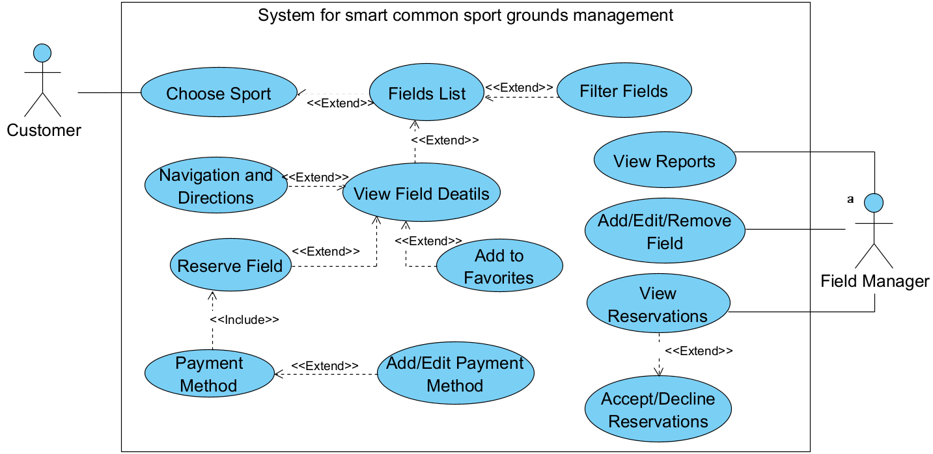
Use Case
‹#›

Slide 15
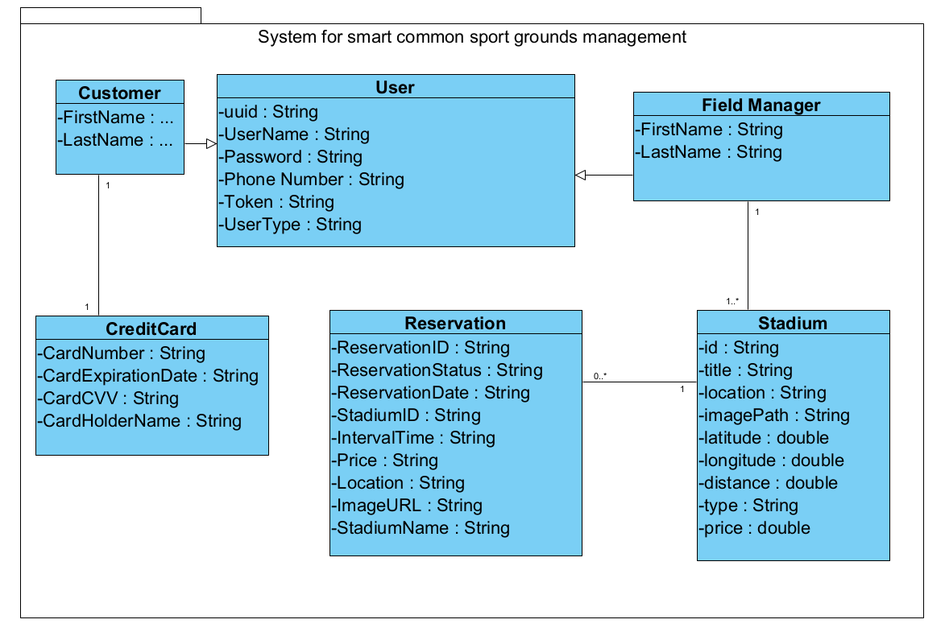
Class Diagram
‹#›

Slide 16
Unit tests
No# | Test Subject | Expected Result | Result
Login form
1 | Enter an empty username or password | Error displays a message: “Please enter a Username/Password”. | Passed
2 | Enter the wrong username or password | Error displays a message: “Wrong Credentials” | Passed
3 | Enter a password shorter than 6 Characters | Error Displays: “Password must be at least 6 characters long” | Passed
4 | Enter a valid username and password | Navigate to Home with message: Welcome “name_of_user”. | Passed
Manager’s add field form
6 | Enter empty details (one or more) | Display message: “Fields cannot be empty”. | Passed
7 | Enter valid field details | Display a message: “Field Added Successfully”. | Passed
‹#›

Slide 17
Functional tests
No# | Test Subject | Expected Result | Result
Login form
8 | Login with a valid Customer username and password | Move to the Categories Page “the homepage of the customer” | Passed
9 | Login with a valid manager username and password | Move the manage field screen of the manager | Passed
Add new reservation
11 | Submit a new reservation while logged in as a customer | The reservation will appear in “Reservations” Tab under “Pending” | Passed
12 | Manager Accepts the reservation of the customer | The customer will see the reservation in the Reservation tab under “Accepted” | Passed
13 | Manager Declines the reservation of the customer | The customer will see the reservation in the Reservation tab under “Canceled” | Passed
‹#›

Slide 18
Technical Challenges
We opted for new technologies like Flutter/Dart, Python with SQLAlchemy, and PostgreSQL, requiring significant self-learning during implementation.
We integrated Google Maps in order for the user to have an exact location of the field , and to help faster the search for a certain field
We used Place Details, Search, and Autocomplete to streamline location searches.
We integrated Google-Sign In in order for users to have a quick access for the APP, for a better user experience.
Notes:
We have faced many technical challenges like learning Flutter/Dart from the ground up, and python with SQLAlchemy. Which required alot of self learning during the implemantation We have integrated Google Maos in order for the user to find a certain field as soon as possible WE have used Google place API in order to help us search throught the MAP Also integrated Google Sign in in order to make a better user experience all of those required self learning and hard work to implement them perfectly

Slide 19
Thank you for your
attention!
‹#›

